Slide 1
Fort Bend ISD Programs of Choice

Slide 2
Agenda
Agenda
Revised Ranking Policy
HS Programs of Choice
Application and Selection Process
Program Requirements
A closer look at each Academy/ P-TECH/ ECHS
Important Dates

Slide 3
EIC Rank Policy
Starting with the class of 2028 all students in a program of choice will be ranked at the campus they attend.

Slide 4
High School Programs of Choice
P-Tech – Computer Science
Willowridge
P-Tech – Health Science
Hightower
Early College
Marshall
Digital Media Academy
Hightower HS
Engineering Academy
Elkins HS
Global Studies Academy
Travis HS
International Business & Marketing Academy
Travis HS
Math & Science Academy
Dulles HS
Medical Science Academy
Hightower HS

Slide 5
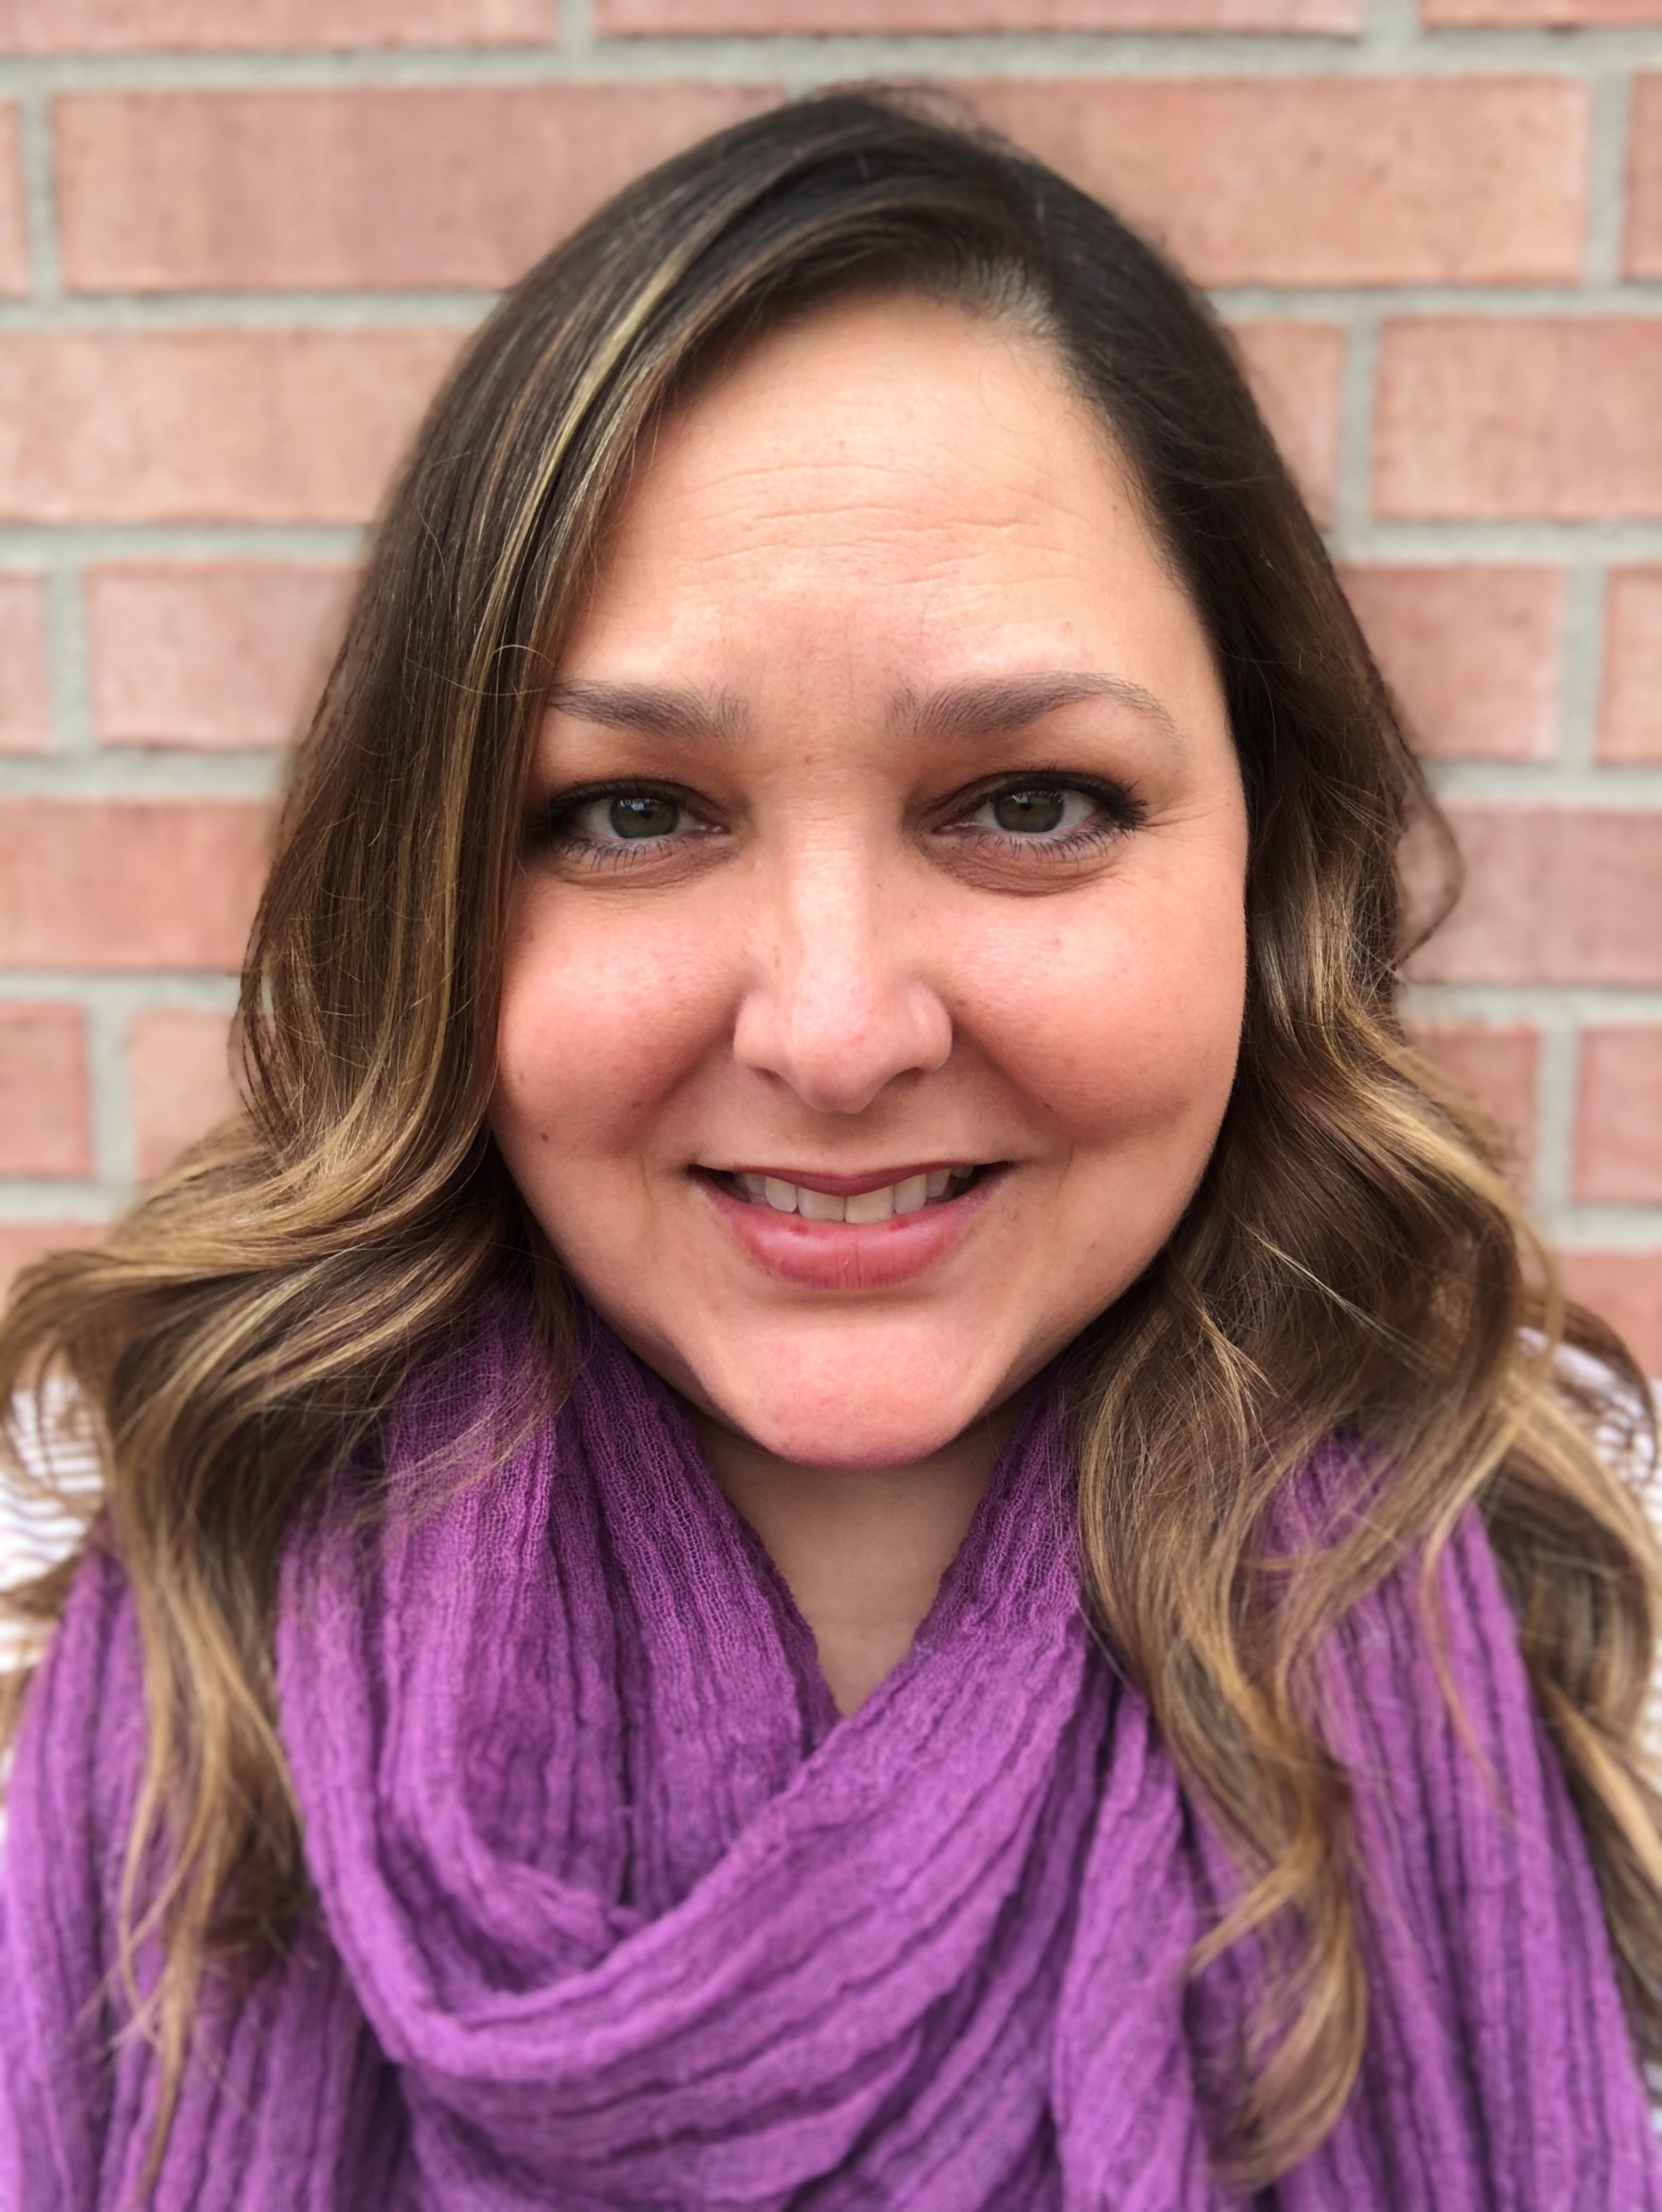
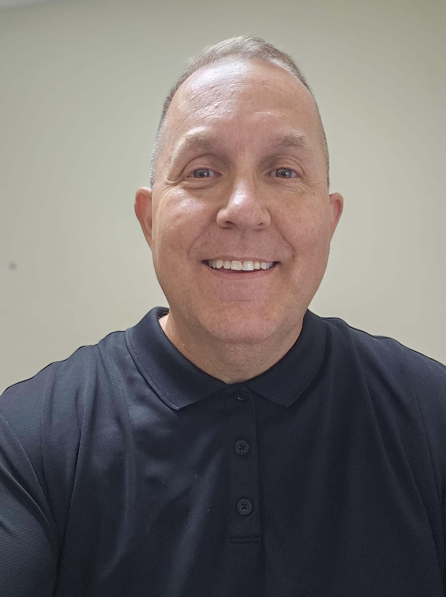
STEM Academies
Humanities Academies
Medical Science
Hightower HS
Engineering
Elkins HS
Math and Science
Dulles HS
Digital Media
Hightower HS
Global Studies
Kempner HS*
Business & Marketing
Kempner HS*
*Kempner HS for classes of 2028 and beyond.
Travis HS for Classes of 2024 to 2027.
P-Tech and Early College

Slide 6
Who Can Apply for FBISD Programs of Choice
Academies
8th graders zoned to Fort Bend ISD
Meets or Masters level in the 7th grade STAAR on related area (Math/Science for STEM academies, ELAR for Humanities)
Proficient/passing scores in 7th grade related courses
P-Tech and Early College
8th graders zoned to Fort Bend ISD

Slide 7
Selection Process
Academies
Valid applicants will complete:
Entrance exam for STEM academies
Interview for Humanities academies
Students qualify based on their composite score
Composite Score
7th-grade Grades + Entrance Exam/Interview Score
P-Tech and Early College
Lottery System

Slide 8
Academies - Commitment to Excellence
Academies
Access to special classes in a specific field of study
Whole-child approach
Preparation for college
Rigorous Coursework

Slide 9
Academy Requirements
Academy Requirements
Academic
Enrichment
Service
Behavior

Slide 10
Academy Requirements
Academic
Enroll in required academy-specific advanced courses
Maintain 75% and above average for academy-specific courses
Enrichments
Service
Complete 25 YES volunteer hours per year for a total of 100 by April 1st of senior year.
Behavior
Maintain 70% and above for all other courses
Complete an enrichment every nine-week period
Students must stay in good behavior standing.
Behavior referrals may result in dismissal from the academy (see handbook).
Complete capstone/senior course/graduation project
4 enrichment activities per year for a total of 16 by graduation.
Volunteer opportunities shared through the newsletter.
Students can find opportunities as well.

Slide 11
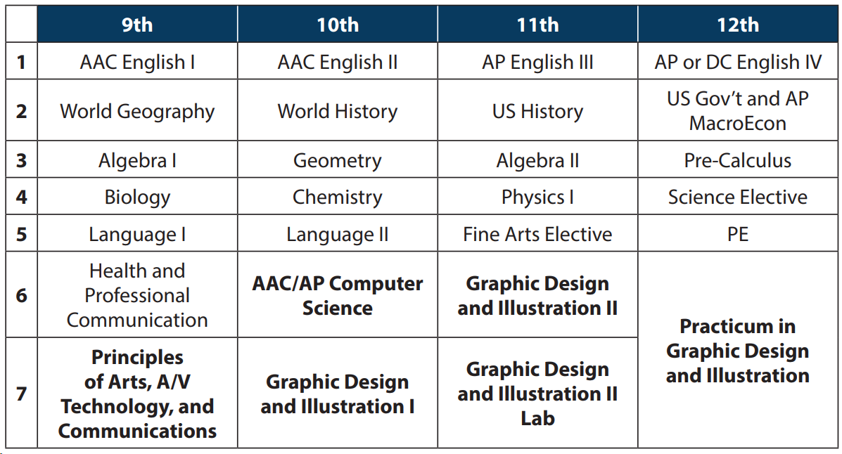
Academic Requirements:
5 Digital Media Credits
Enroll in AAC/AP or Dual Credit English all four years
Complete all appropriate course certifications: Adobe Photoshop and Adobe Illustrator (When students complete both they receive a Professional Visual Designer Certificate)
Practicum/ Internship with the FBISD Print Shop
Portfolio Development
Students develop a Freelance Contract/ License to use with clients

Slide 12
Academic Requirements:
Complete four consecutive years of a Language Other Than English (LOTE)
Complete a minimum of (5) Social Studies credits
Complete AAC/AP or Dual Credit English all four years
Complete Academy Capstone Senior Course

Slide 13
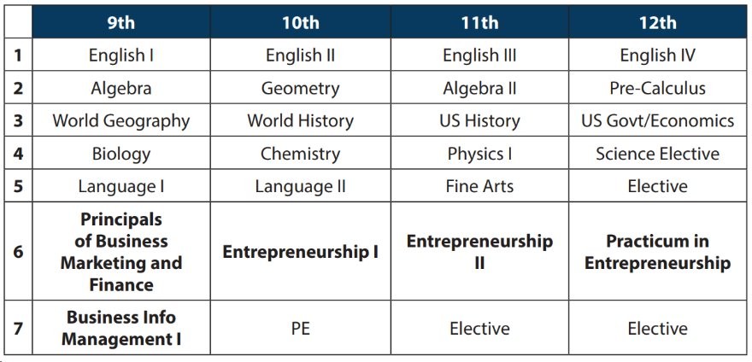
Academy Requirements:
Complete six
Business and/or marketing credits in the designed sequence during the school year designated
Complete four credits in qualifying advanced coursework (AAC, AP, or DC)
Complete all appropriate course certifications: Microsoft Specialists in Word and Excel

Slide 14
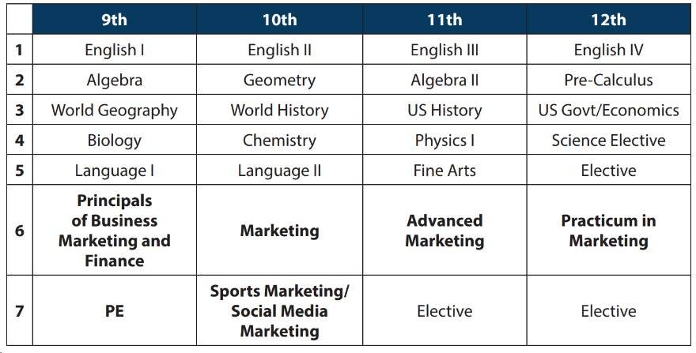
Academic Requirements:
Complete six Marketing credits in the designed sequence during the school year designated
Complete four credits in qualifying advanced coursework (AAC, AP, or DC)
Complete all appropriate course certifications: Microsoft Specialists in Word and Excel

Slide 15
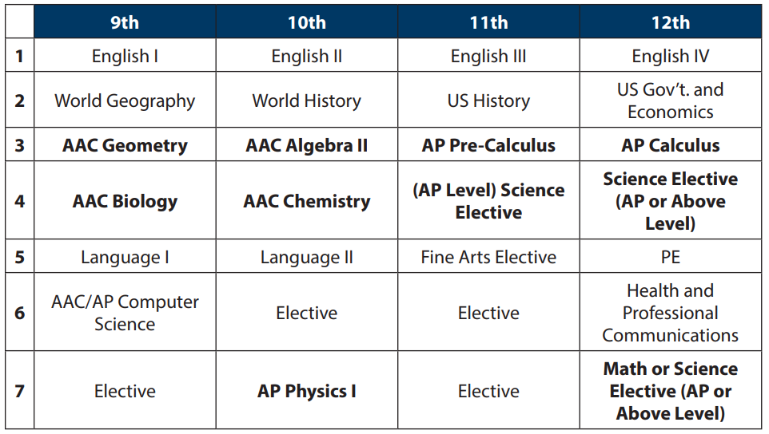
Academic Requirements
Complete at least 10 credits through a combination of math and science courses (can be 5 math/5 science or 4 math/6 science or 6 math/4 science) inclusive of Calculus AB or BC.
Enrolled in AAC, AP, Honors, or Dual Credit math and science courses all four years on the campus.
1 Computer Science Credit. Computer Science 1 AAC or higher.
Complete 1 graduation project from the approved list.

Slide 16
Academic Requirements
Complete the Engineering Academy course pathway.
Must be enrolled in advanced (AAC, AP, Honors) math and science courses all four years on the campus.
Must complete 1 advanced Computer Science Credit. Computer Science 1 AAC or higher.
Complete a senior-level capstone course specific to the pathway (PLTW course).

Slide 17
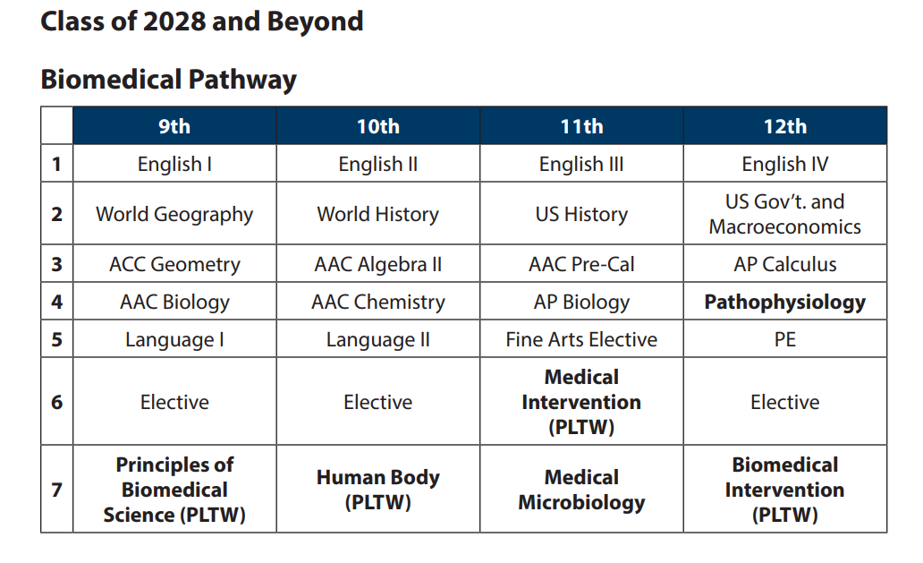
Academic Requirements
Complete the Medical Science Academy course pathway.
Enroll in AAC, AP, or Honors science courses all four years on the campus.
Encouraged to take advanced-level math courses all four years.
Complete a senior-level capstone course specific to the pathway (PLTW course or practicum).

Slide 18
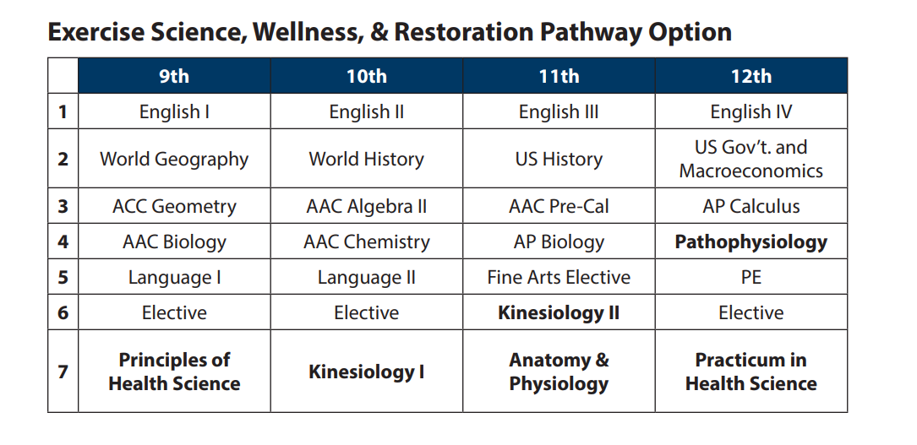
Academic Requirements
Complete the Medical Science Academy course pathway.
Enroll in AAC, AP, or Honors science courses all four years on the campus.
Encouraged to take advanced-level math courses all four years.
Complete a senior-level capstone course specific to the pathway (PLTW course or practicum).
This pathway will not be offered for the Class of 2028

Slide 19
Summer Courses
Academy-required courses are taken at the host campus during the school year to count for the academy.
Students may take academy-required courses the summer before 9th grade.

Slide 20
Fort Bend ISD Early College Models
Fort Bend ISD offers the following three ECHS program models:
P-TECH at Hightower HS- Offering an Associates of Applied Science in Allied Health/
P-TECH at Willowridge HS- Offering an Associates of Applied Science in Computer Programming
Early College at Marshall HS- Offering and Associates of Arts in Multidisciplinary Studies and an Associates of Science in General Studies

Slide 21
P-TECH (Pathways in Technology Early College High Schools)​ and ECHS (Early College High School) Benefits
P-TECH/ Early College High Schools:
Provide dual credit at no cost to students
Offer rigorous instruction and accelerated courses
Provide academic and social support services to help students succeed
Increase college readiness and
Reduce barriers to college access.

Slide 22
Important Dates
October 1st–31st
Career Readiness Roadmap (Virtual)
October 1st
Career Readiness Roadmap Fair at Reese
November 1st
Application window opens
September 25th
Recruitment at Middle Schools
Application Window
November 1st – November 30th

Slide 23
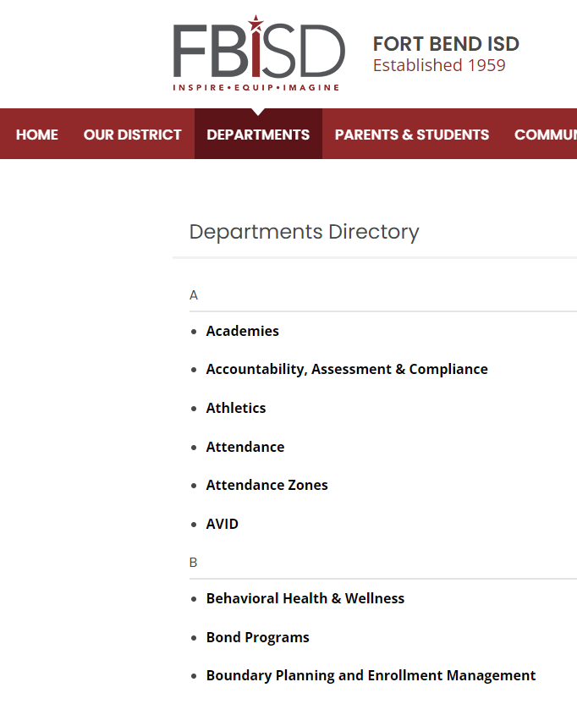
We Need Your Support!
Sign up for our visit!
Promote our programs
Direct parents and students to our website
Remind them of the application window
November 1st – 30th

Slide 24
Questions

Slide 25
Thank you and have a fantastic year!

